Slide 1

Parallel and Distributed Computing
A Modern Approach to High-Performance Systems
Md. Mostafizur Rahman
Md. Rakibul Hasan Rakib,
Md. Rakib Hosain Porosh
Arbi Akbar

Slide 2
Introducton
Growing demand makes sequential computing inadequate
Requires massive power for simulations, weather, finance, AI
Parallel computing → tasks split, faster execution
Distributed computing → networked systems, scalable & reliable

Slide 3
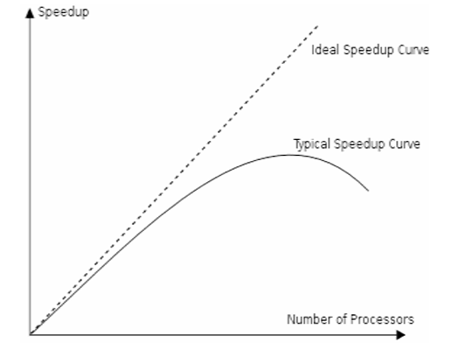
Performance
Models
• Speedup: S(n) = T(1) / T(n)
• Efficiency: E(n) = S(n) / n
• Scalability: ability to use more processors

Slide 4
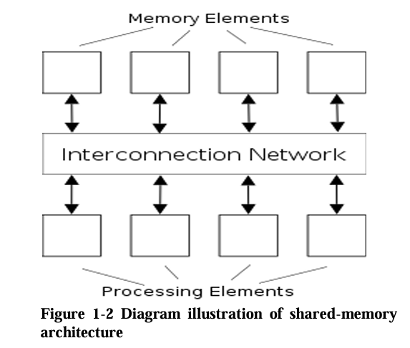
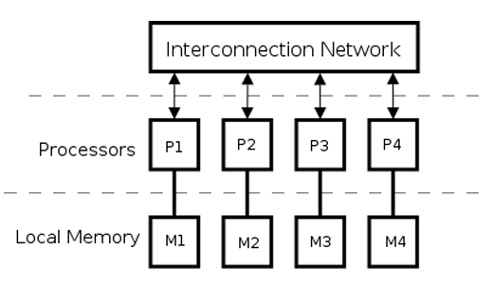
Execution
Models
Shared Memory Model
- Common memory, synchronization needed
Distributed Memory Model
- Local memory, communication via message passing

Slide 5
Applications
• Scientific Research – simulations, weather, space
• Big Data – Hadoop, Spark
• AI – Deep learning on GPUs/clusters
• Cloud Computing – AWS, Azure, GCP
• Healthcare – Genome sequencing
• Finance – Fraud detection, predictions

Slide 6
Challenges
&
Limitations
• Communication overhead
• Synchronization issues
• Load balancing difficulties
• Scalability limits
• Fault tolerance
• Energy consumption
• Security concerns

Slide 7
Conclusion
• PDC revolutionizes high-performance computing
• Parallel → speed & efficiency
• Distributed → scalability & reliability
• Supports AI, big data, cloud, science
• Challenges remain: synchronization, energy
• Future: Exascale systems, Quantum, Edge AI

Slide 8
Thanks
THANK YOU FOR LISTENING

